Slide 1
Home
Room
Avatar
Emoticon
Setting
MeetingRoom
GameRoom
Home
Room
Avatar
Emoticon
Setting
CREATE
ROOM
Room #1
(1/4)
Room #2
(2/8)
Room #3
(3/4)

Slide 2
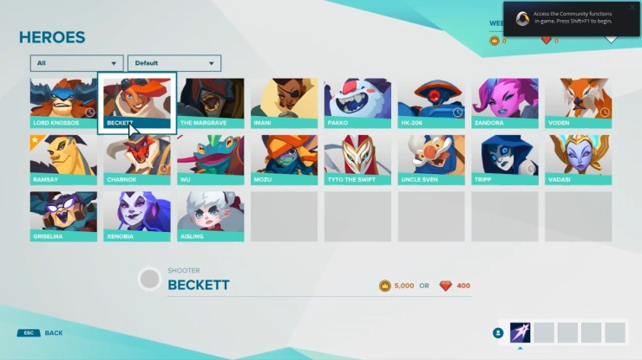
Home
Room
Avatar
Emoticon
Setting

Slide 3

Home
Room
Avatar
Emoticon
Setting

